Slide 1
Predicting User Intent based on Search Queries
Kiyan Rezaee – 13 July 2022

Slide 2
Technical background
ANN
RNN
NLP
LDA Topic Modeling

Slide 3
Types of general intents
General intents
Informational
Transactional
Navigational

Slide 4
The SNIPS
16000 queries
SearchCreativeWork
GetWeather
BookRestaurant
PlayMusic
AddToPlaylist
RateBook
SearchScreeningEvent

Slide 5
ATIS dataset
It contains 8 unique intent categories
atis_flight
atis_flight_time
atis_airfare
atis_aircraft
atis_ground_service
atis_airline
atis_abbreviation
atis_quantity

Slide 6
Balanced vs Unbalanced datasets

Slide 7
Model
BERT
Ludwig

Slide 8
Metrics
Precision
Recall
F1-score
Confusion matrix

Slide 9
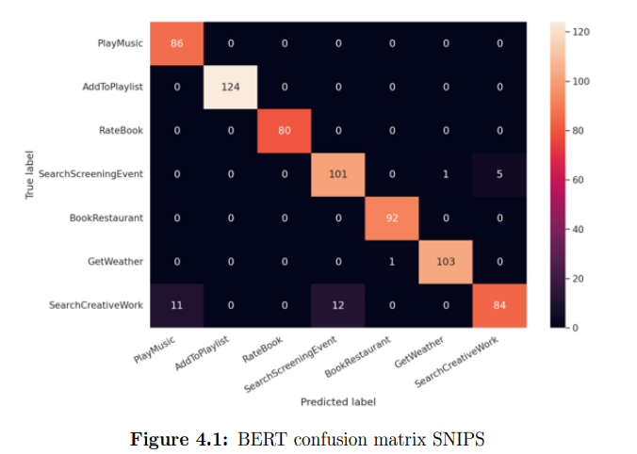
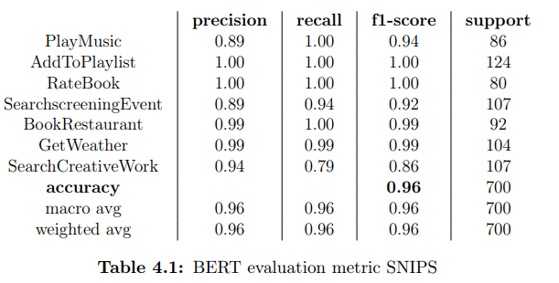
Results…

Slide 10
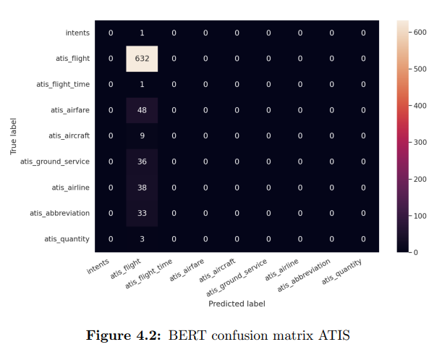
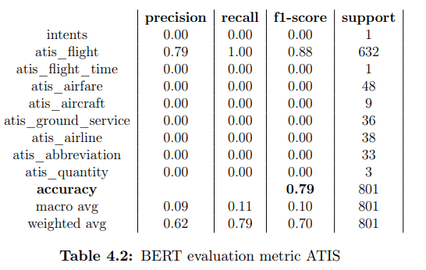
Results…

Slide 11
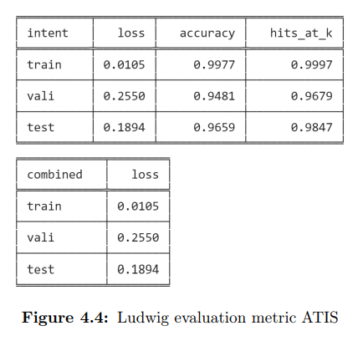
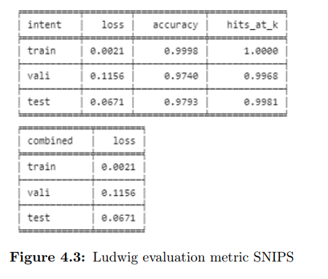
Results…

Slide 12
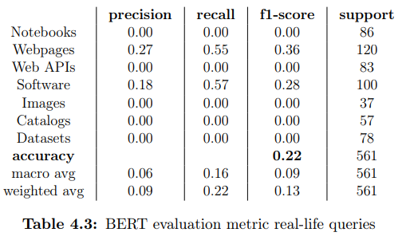
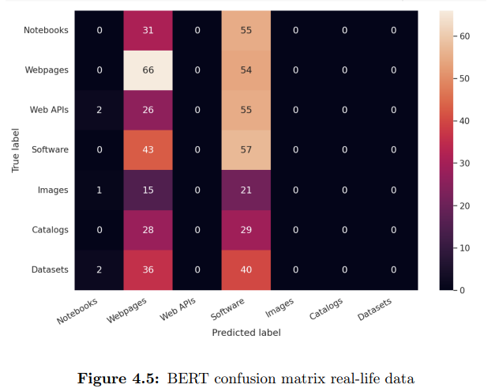
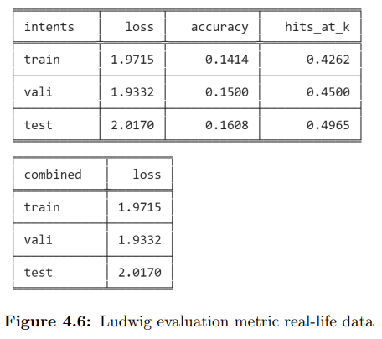
BERT and Ludwig trained on real-life data

